Slide 1
Build X: Android
Lecture Five: Putting it All Together
Notes:
https://tinyurl.com/kcl-tech-android-notes

Slide 2
Recap

Slide 3
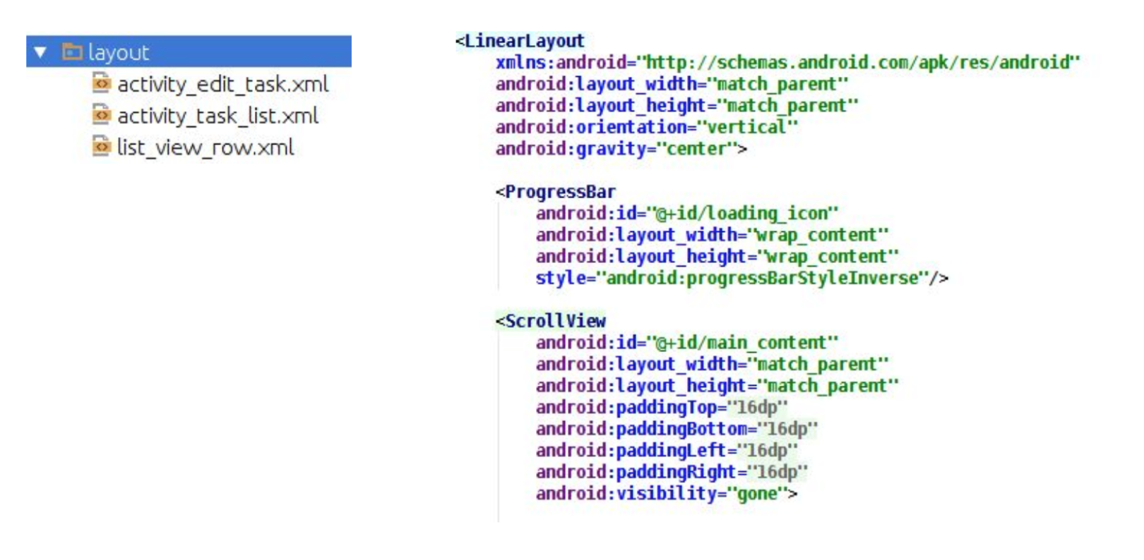
Recap – Layouts, Views and View Groups

Slide 4
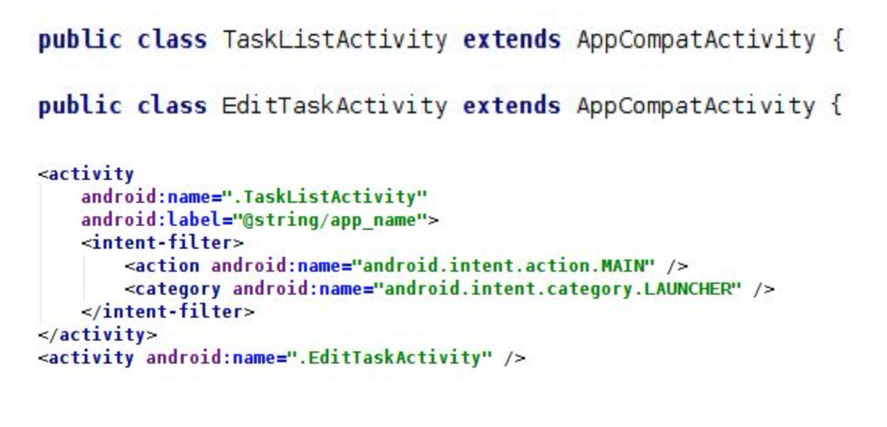
Recap – Events, Intents and the Activity Lifecycle

Slide 5
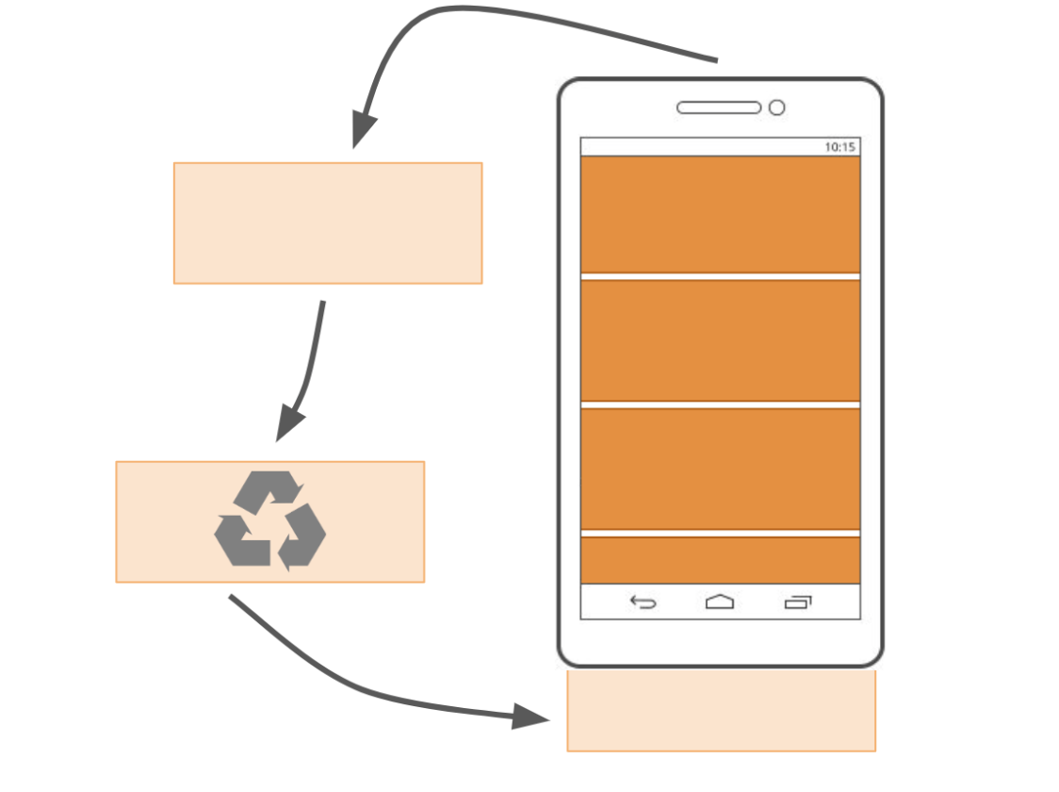
Recap - ListViews

Slide 6
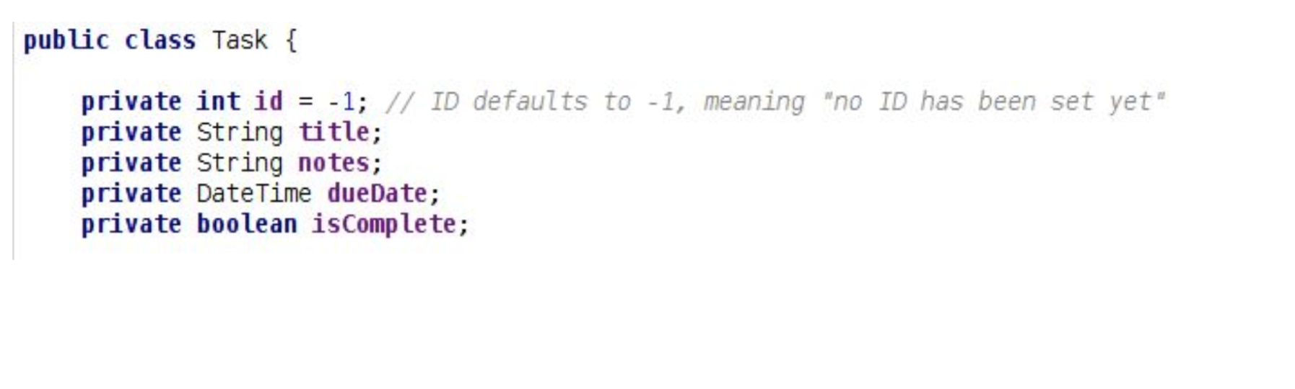
Recap - Models

Slide 7
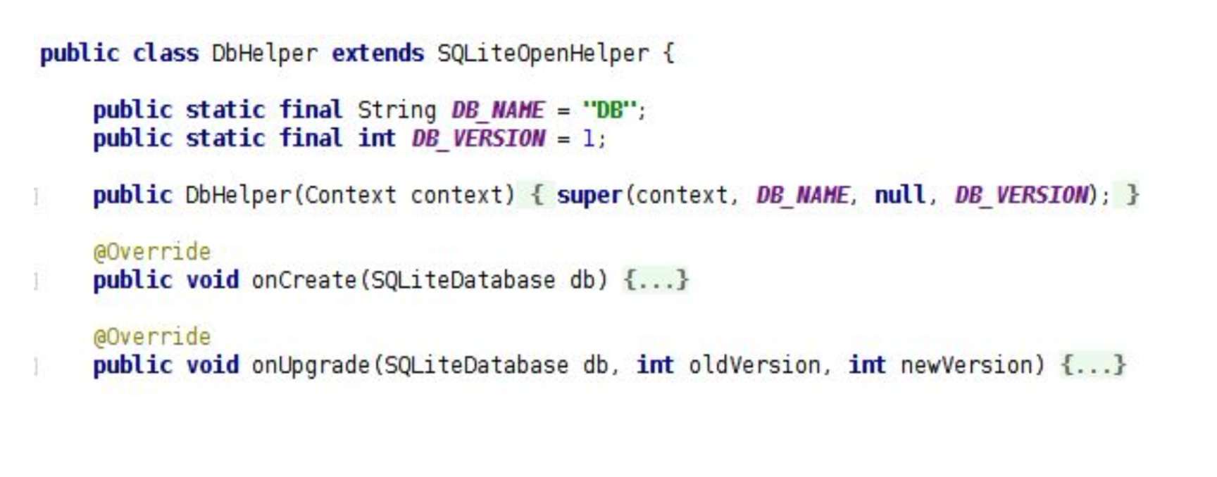
Recap - Databases

Slide 8
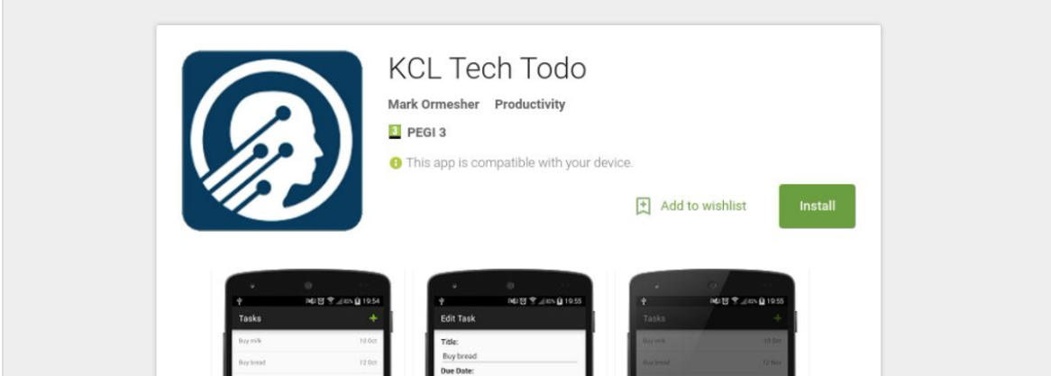
What are we doing?
Course Notes:
https://tinyurl.com/kcl-tech-android-notes
We’re want to build a basic todo list app, KCL Tech Todo.
If you want a preview, it is available on Google Play.
Search for ”KCL Tech Todo” on Google or on the Play Store.

Slide 9
Time to put it all together!

Slide 10
What features does our TODO app need to have?

Slide 11
What do YOU have to do?

Slide 12
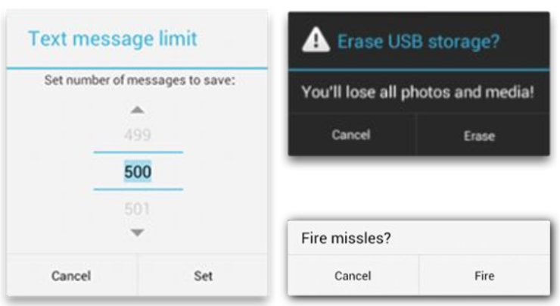
Alert Dialogs
An alert dialog is a “pop-up” on Android that can contain pretty much anything that you want.
Text, an image, input fields, progress bars, buttons, etc.

Slide 13
Alert Dialogs: Builders
We could create one from scratch, but it’s easier to use a design pattern called a builder.
The builder pattern is used in many languages and works like a real builder: you tell them how you want a complex object to look/work, and they build it for you.

Slide 14
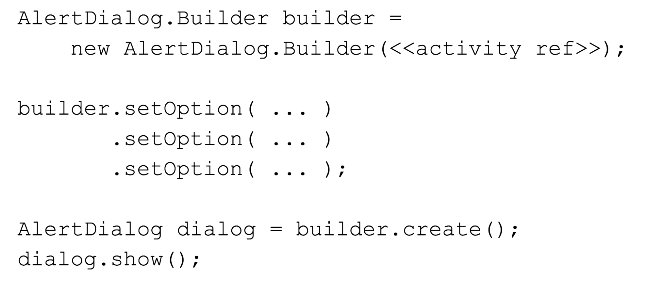

Slide 15
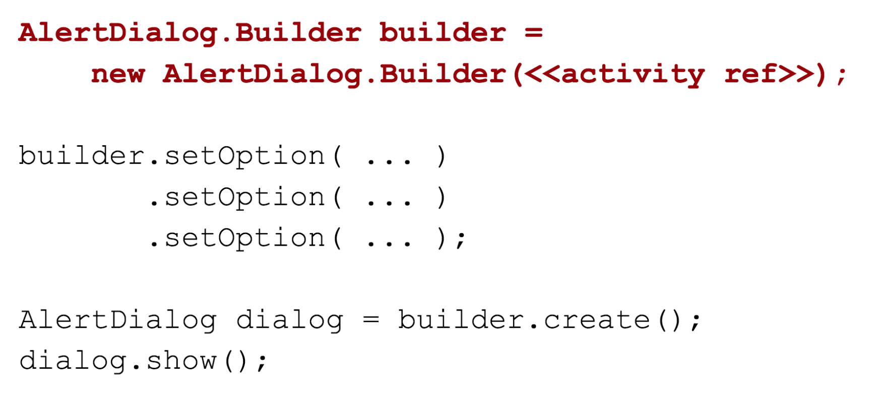

Slide 16
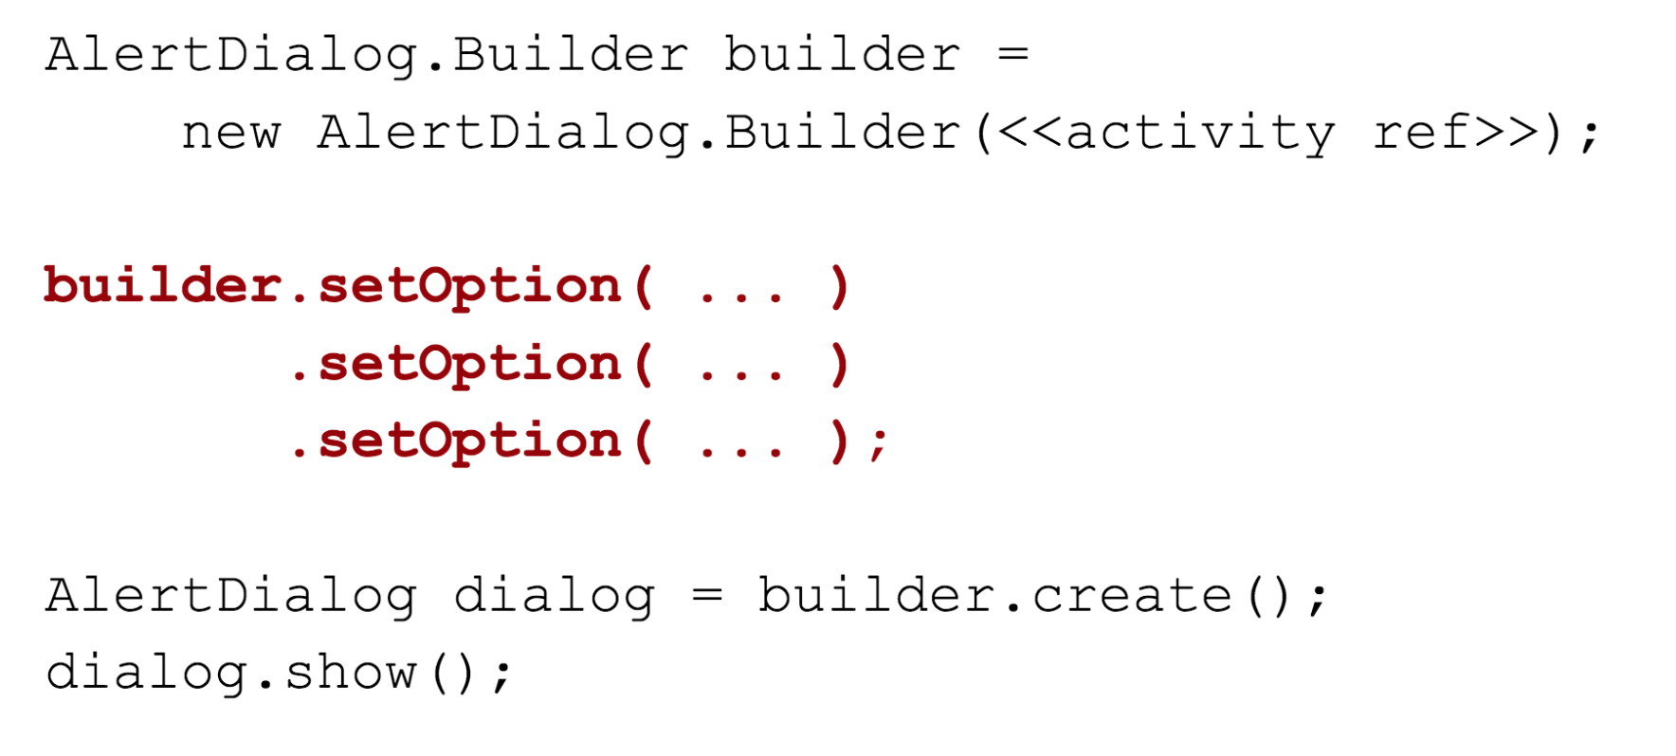

Slide 17
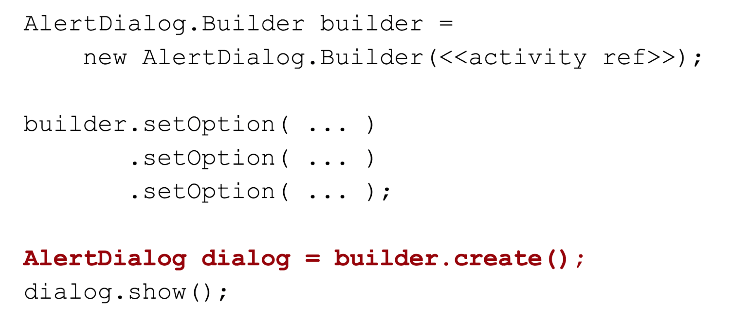

Slide 18
